Slide 1




Slide 2
Automatic Target Recognition by robotic arm
Final Presentation

Slide 3
Stakeholders
Guided by:
Sir. Mughees Sarwar Awan
Industrial Supervisor:
Dr. Khursheed Hussain
Industry:
AI-TECH
Submitted by:
Saddam Ahmed Nisar (192101024)
Nouman Mazhar (192101014)
Iqra Tanveer (192101015)

Slide 4
Outlines
Introduction
Application
Motivation
Problem Statement
Objectives
Object Detection Algorithms
Robotic Arm
Literature View
Design and Implementation
Expected Result
Proposed Cost
Project Timeline
Conclusion
References

Slide 5
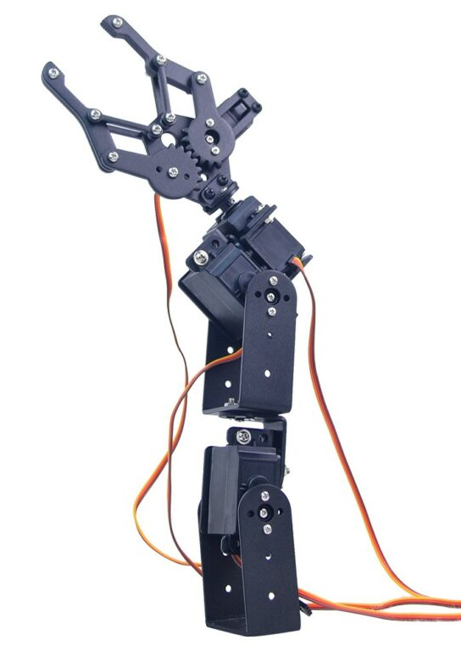
Introduction
An automatic target recognition is a real time or non-real-time image or signal understanding system. It involve image processing and machine learning techniques to detect and identify the object in its environment[1]. The main aim of our project is to Detect, identify and tacking of dynamic object by using robotic arm then pick the dynamic object and place it on another location by using swin transformer .

Slide 6

Problem statement
As the object is moved from the pre-fixed position , the robotic arm is unable to detect and track the object.

Slide 7
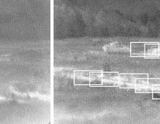
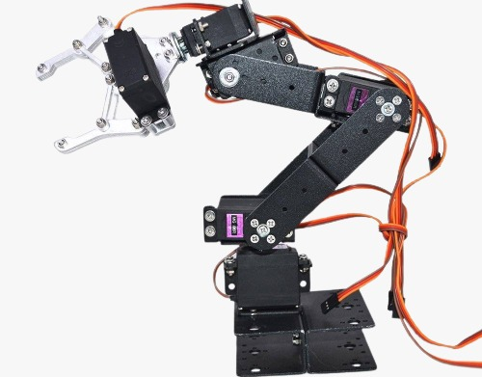
Objectives
Detection of moving object under robotic arm.
Identification of detected object and tracking of object of interest.
Pick and place the targeted object.
Accurate and efficient detection of targets in environment.
Safety and flexibility.
FIGURE 1.2 Automatic detection and robotic arm

Slide 8
Motivation
To provide ease to the workers working in factory just doing pick & place for whole day.
To carry Radioactive Materials where human arm is risky to use.
In Corona Virus Pandemic Situation, contactless applications.

Slide 9

Literature Review
The Author Rahul kumar proposed a system in which he used image processing algorithm which is a pre-requisite for the full operation of a pick and place Robotic arm. The major challenge faced in developing the test subjects in compliance with the classifier parameters [1].
The Author Jesmin F.khan describes an algorithm for the detection of low and high-contrast targets in forward-looking infrared imagery while rejecting the effects of clutter and other associated detrimental factors [2].
The Author Yiming Zuo Proposed a system that create a large number of synthetic data, trains a vision model in this virtual domain by using 3D model and applies it to real-world images after domain adaptation [3].

Slide 10
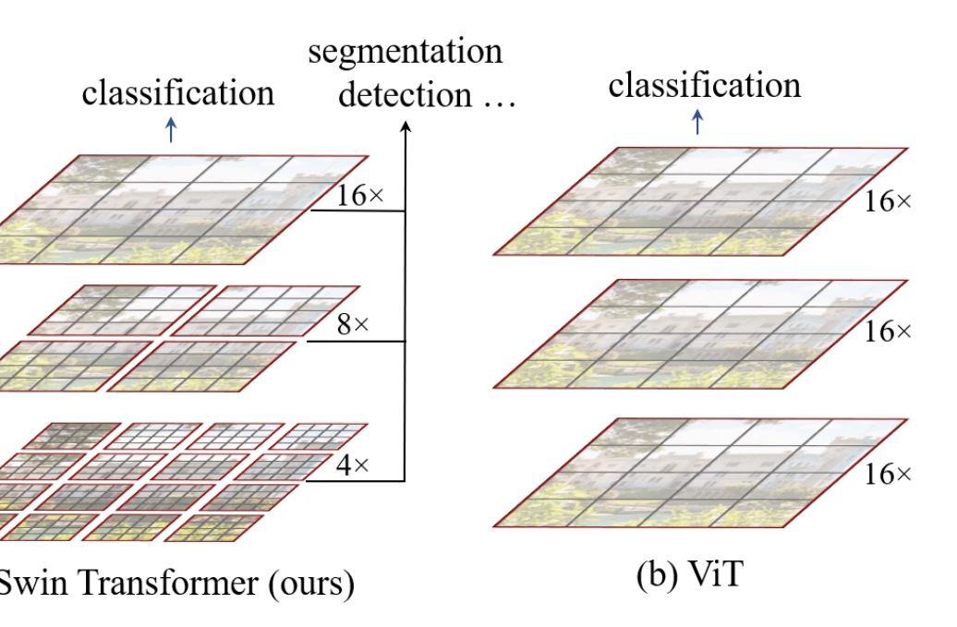
Algorithm
The Swin Transformer is a type of Vision Transformer. It builds hierarchical feature maps by merging image patches in deeper layers and has linear computation complexity to input image size due to computation of self-attention only within each local window. The Swin Transformer v2 is a variant of the Transformer architecture, which is a deep learning neural network used in natural language processing tasks such as language translation, text summarization, and sentiment analysis.
Figure 1.3 Swin Transformer and ViT [2]

Slide 11
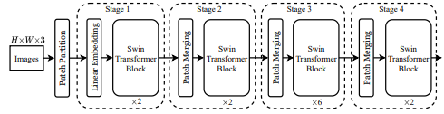
Architecture of Swin Transformer
The image is taken from camera then swin transformer resize the image and converted it into the patches and pass through different stages. Then apply linear embedding line that generate the deeper layer of different dimensions on patches and make swin transformer block that maintain the number of patches.

Slide 12
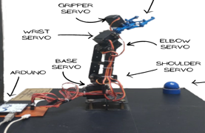
Robotic arm
A robotic arm functions and operates much like the arm of a human, with joints that can move in different directions.
As the robotic arm picks and places objects it offers something that most other machines cannot. Robotic arm consist of five joints that are Base, Shoulder, Elbow, Wrist and Jaws or Gripper.
It has 5 servo motors .Each motor is controlled by Arduino and is moved in accordance with the Arduino code.
4DOF robotic arm

Slide 13
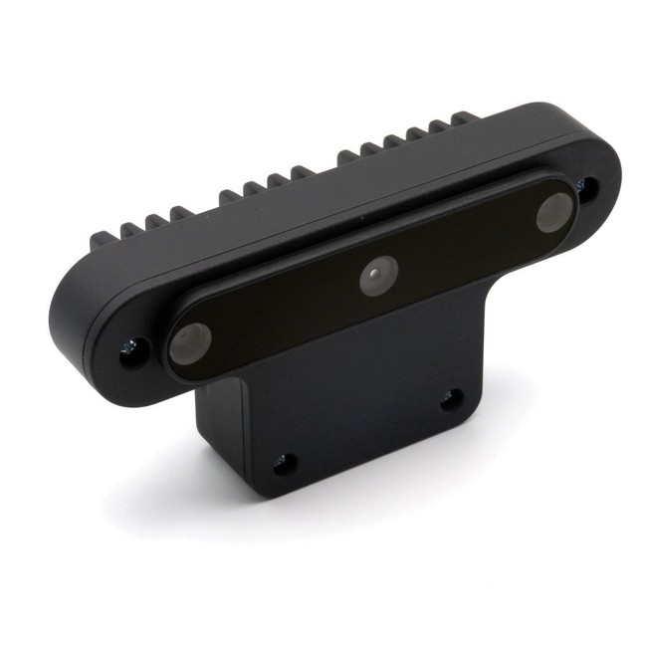
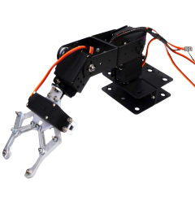
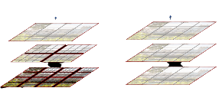
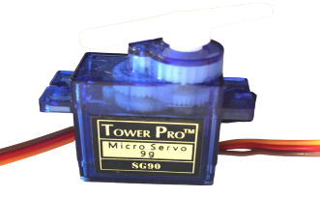
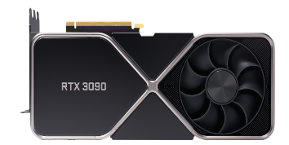
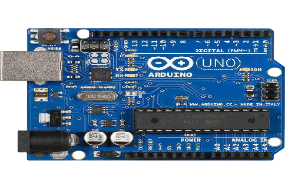
System Design and Implementation
Hardware:
OAK-D
Swin Transformer
GPU Rtx 3090
Robotic Arm
Servo Motor
Arduino Uno

Slide 14



System Design and Implementation(Cont..
Software:
Open CV python
Arduino
Google Collab

Slide 15

METHODOLOGY
Image is taken from the camera as frames.
Camera is connected to computer system.
Our project proposed algorithm of swin transformer that integrate with Swin which build features map by merging image patches(shown in gray) in deeper layer.
After processing it will be handed to the controller, that move the motors according to the coordinates and robotic arm moves accordingly.

Slide 16
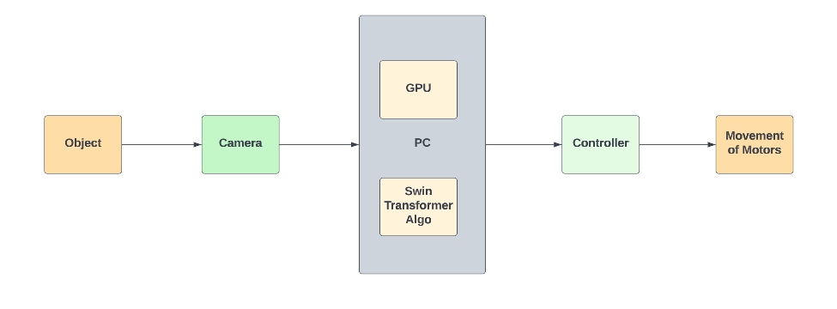
System Design and Implementation(Cont..
Block Diagram of our proposed system:

Slide 17
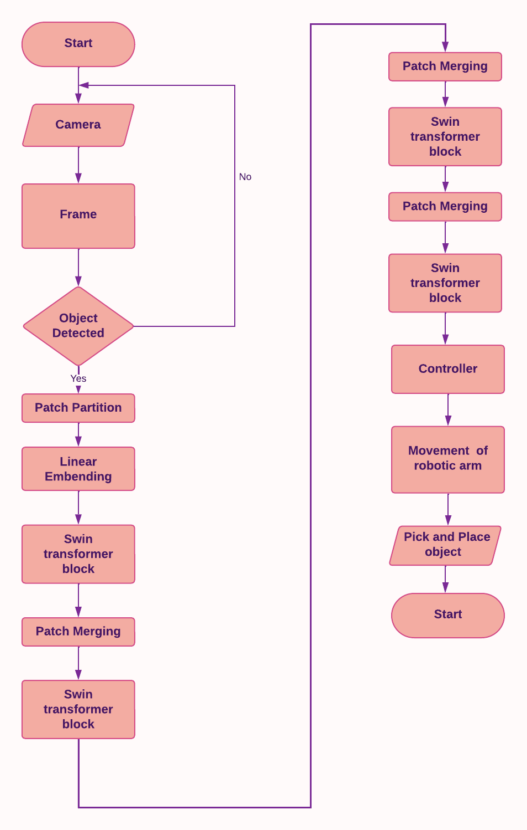
System Design and Implementation(Cont..
Flowchart of our proposed system:

Slide 18
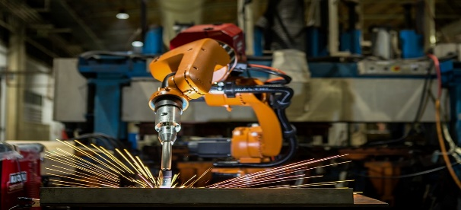
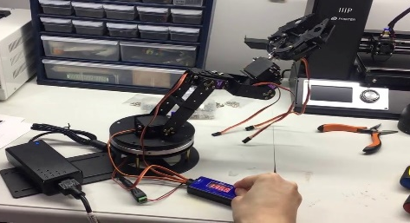
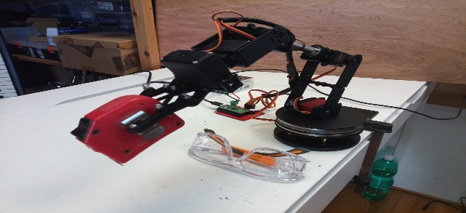
Applications
Robotic arm can be used in welding
For based object sorting
For object pick and place solution
Hazardous Environment
Food Processing
Aerospace Industry

Slide 19
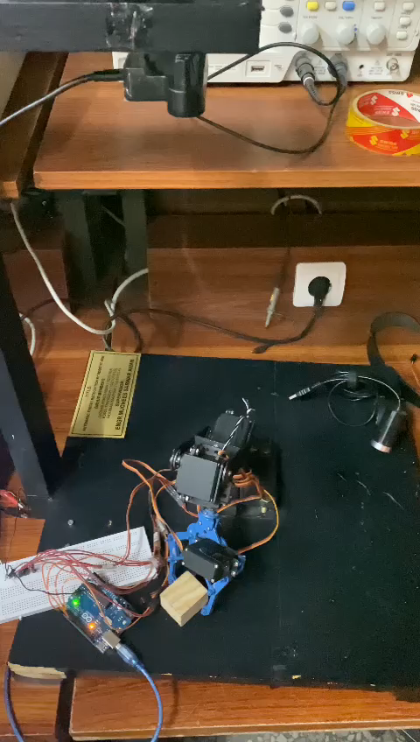
result
Pick and place object

Slide 20
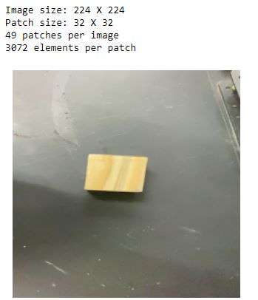
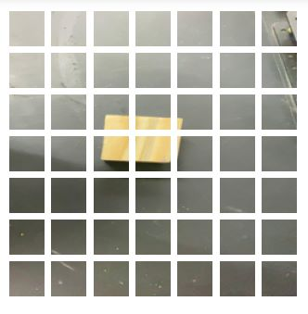
Results
Input image with size Image in Patches

Slide 21
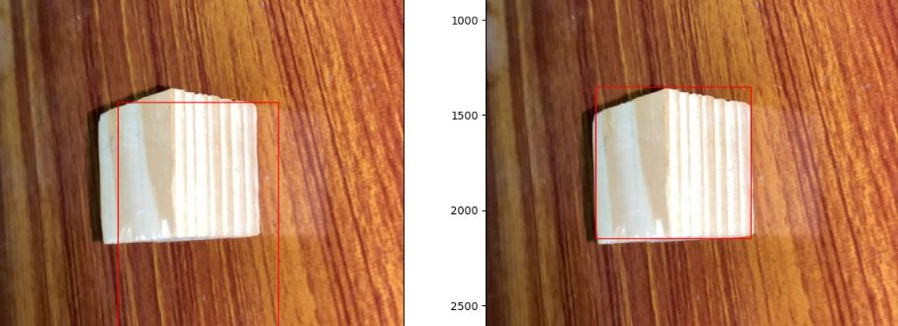
Bounding box on detected object

Slide 22
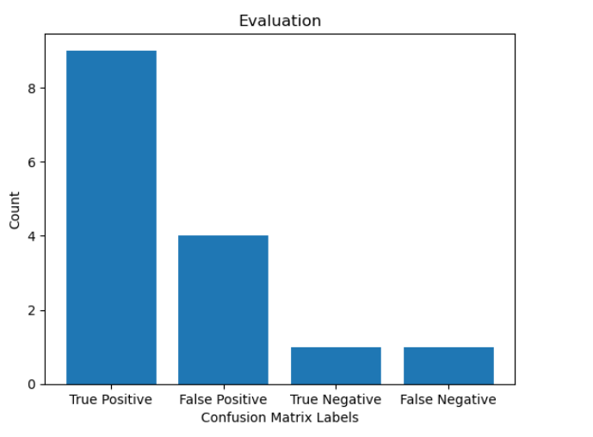
Evaluation Metrics of Dataset Percentage.

Slide 23
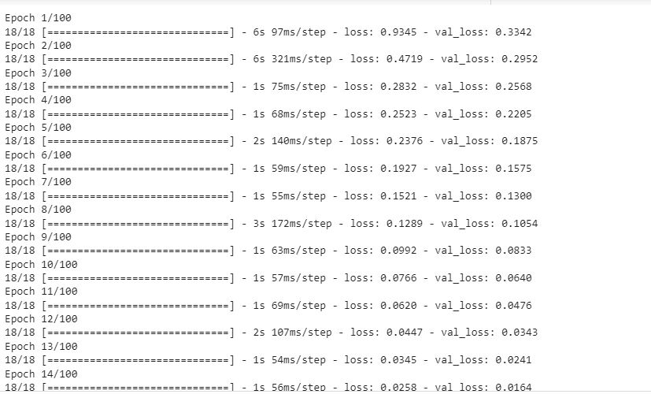
Training DataSet

Slide 24
Final deliverable of the project
Our final product will be software/hardware integrated system of robotic arm.

Slide 25
Cost analysis
Oak-d camera =25000Rs
4DOF robotic arm =9500Rs
GPU RTx 3090t =350000Rs

Slide 26
Conclusion
After making this project, this project will be able to automatically identify, detect and track the dynamic object and pick and place the targeted object through robotic arm

Slide 27
Future Work
Speed and performance, particularly in complicated situations with numerous targets or difficult lighting conditions, can yet be improved.
The robotic arm can detect targets as well as plan and carry out the necessary grasping operations by integrating target recognition and grasp planning. As a result, the arm would be able to involve and control recognized things more meaningfully and purposefully on its own.
Future research on the Swin Transformer and robotic arm for autonomous target detection could concentrate on improving the system's versatility and real-world usability.

Slide 28
References
[1] Kumar R, Lal S, Kumar S, Chand P. Object detection and recognition for a pick and place robot. InAsia-Pacific world congress on computer science and engineering 2014 Nov 4 (pp. 1-7). IEEE.
[2] Khan JF, Alam MS. Target detection in cluttered forward-looking infrared imagery. Optical Engineering. 2005 Jul;44(7):076404.
[3] Zuo, Yiming, et al. "Craves: Controlling robotic arm with a vision-based economic system." Proceedings of the IEEE/CVF Conference on Computer Vision and Pattern Recognition. 2019.

Slide 29


Slide 30


